Slide 1
B6.aa
RNA Seq introduction
Karthik

Slide 2
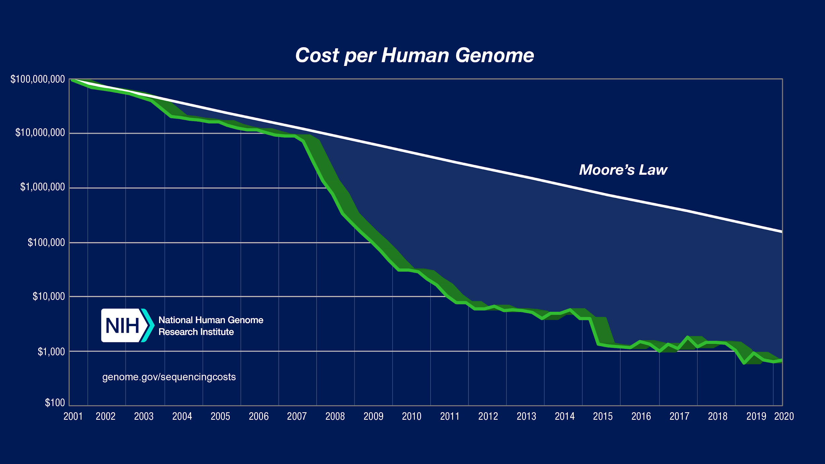
https://www.genome.gov/about-genomics/fact-sheets/Sequencing-Human-Genome-cost

Slide 3
Near complete human genome
First release of human genome excluded upwards of 10% of the genome.
HG38: 161 Mbp of “unknown” sequence constituting 5% of the genome.
Complete chromosomes X and 8 released by T2T Consortium on Sep 22, 2020: https://genomeinformatics.github.io/CHM13v1/

Slide 4
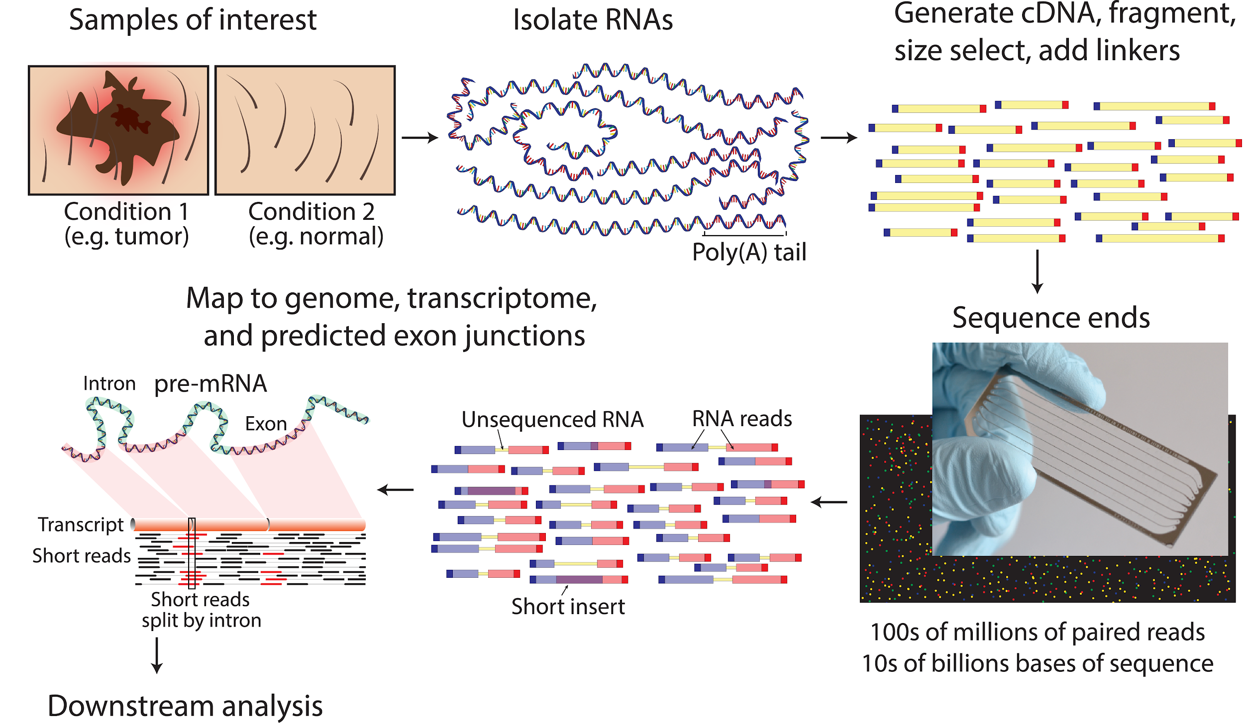
Overview
Griffith et al. 2015

Slide 5
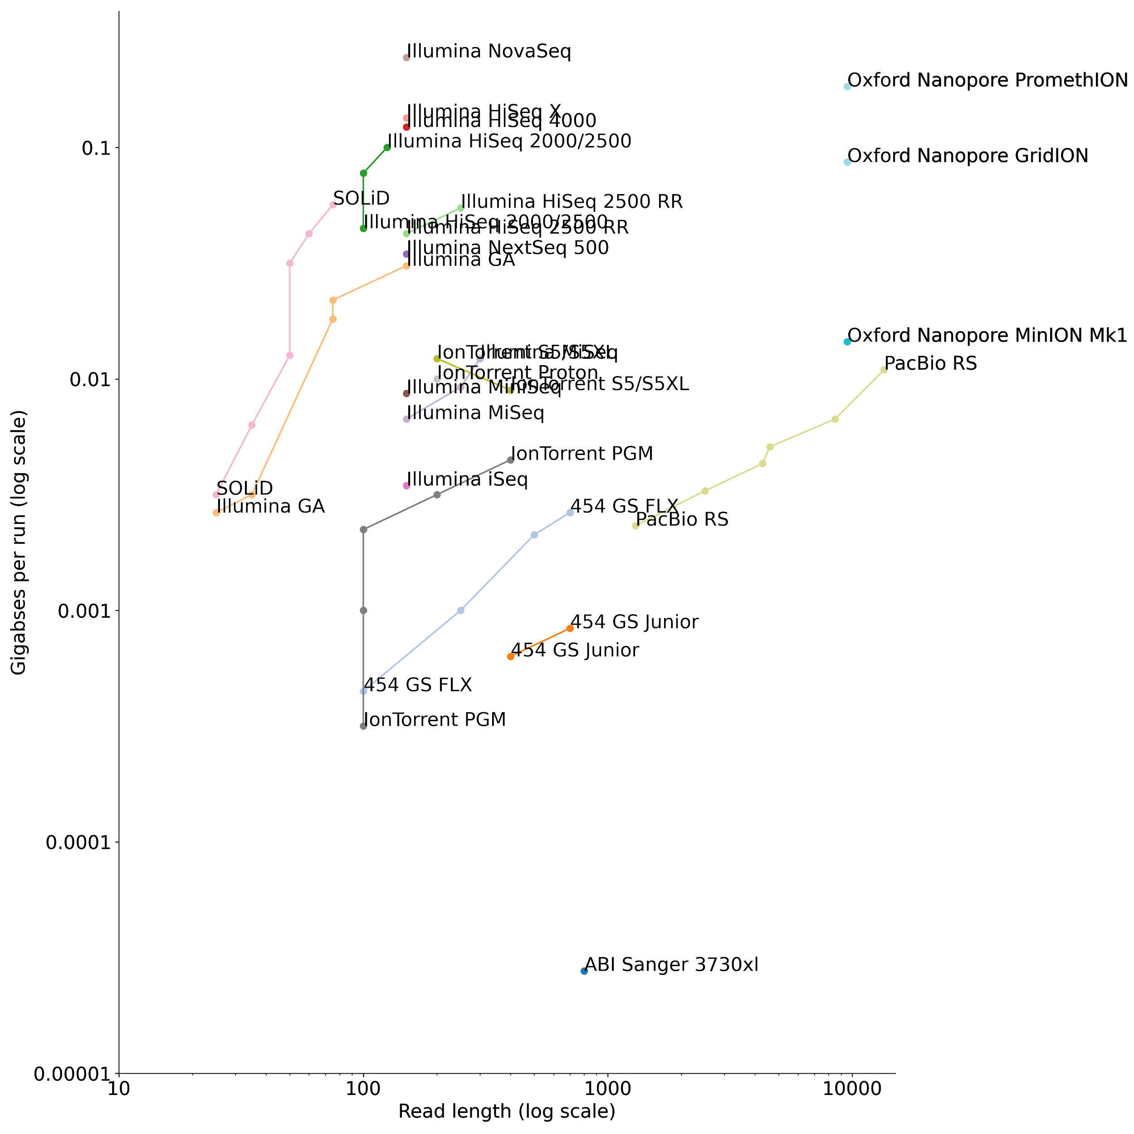
Sequence of sequencers
Long read sequencing
$1000 human genome.
*Nanopore sequencing can yield ultra long reads > 2Mb!
Forked from https://github.com/lexnederbragt/developments-in-next-generation-sequencing

Slide 6
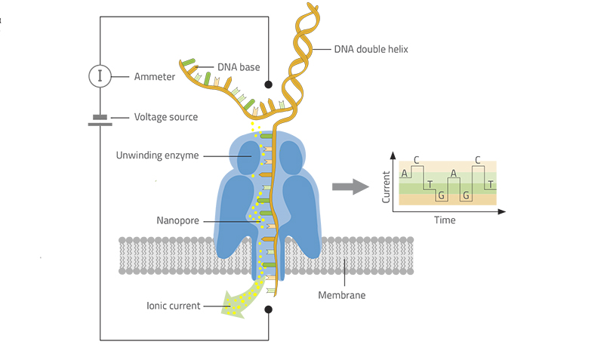
Nanopore sequencing
https://www.youtube.com/watch?v=qzusVw4Dp8w
https://www.scienceinschool.org/content/decoding-dna-pocket-sized-sequencer

Slide 7
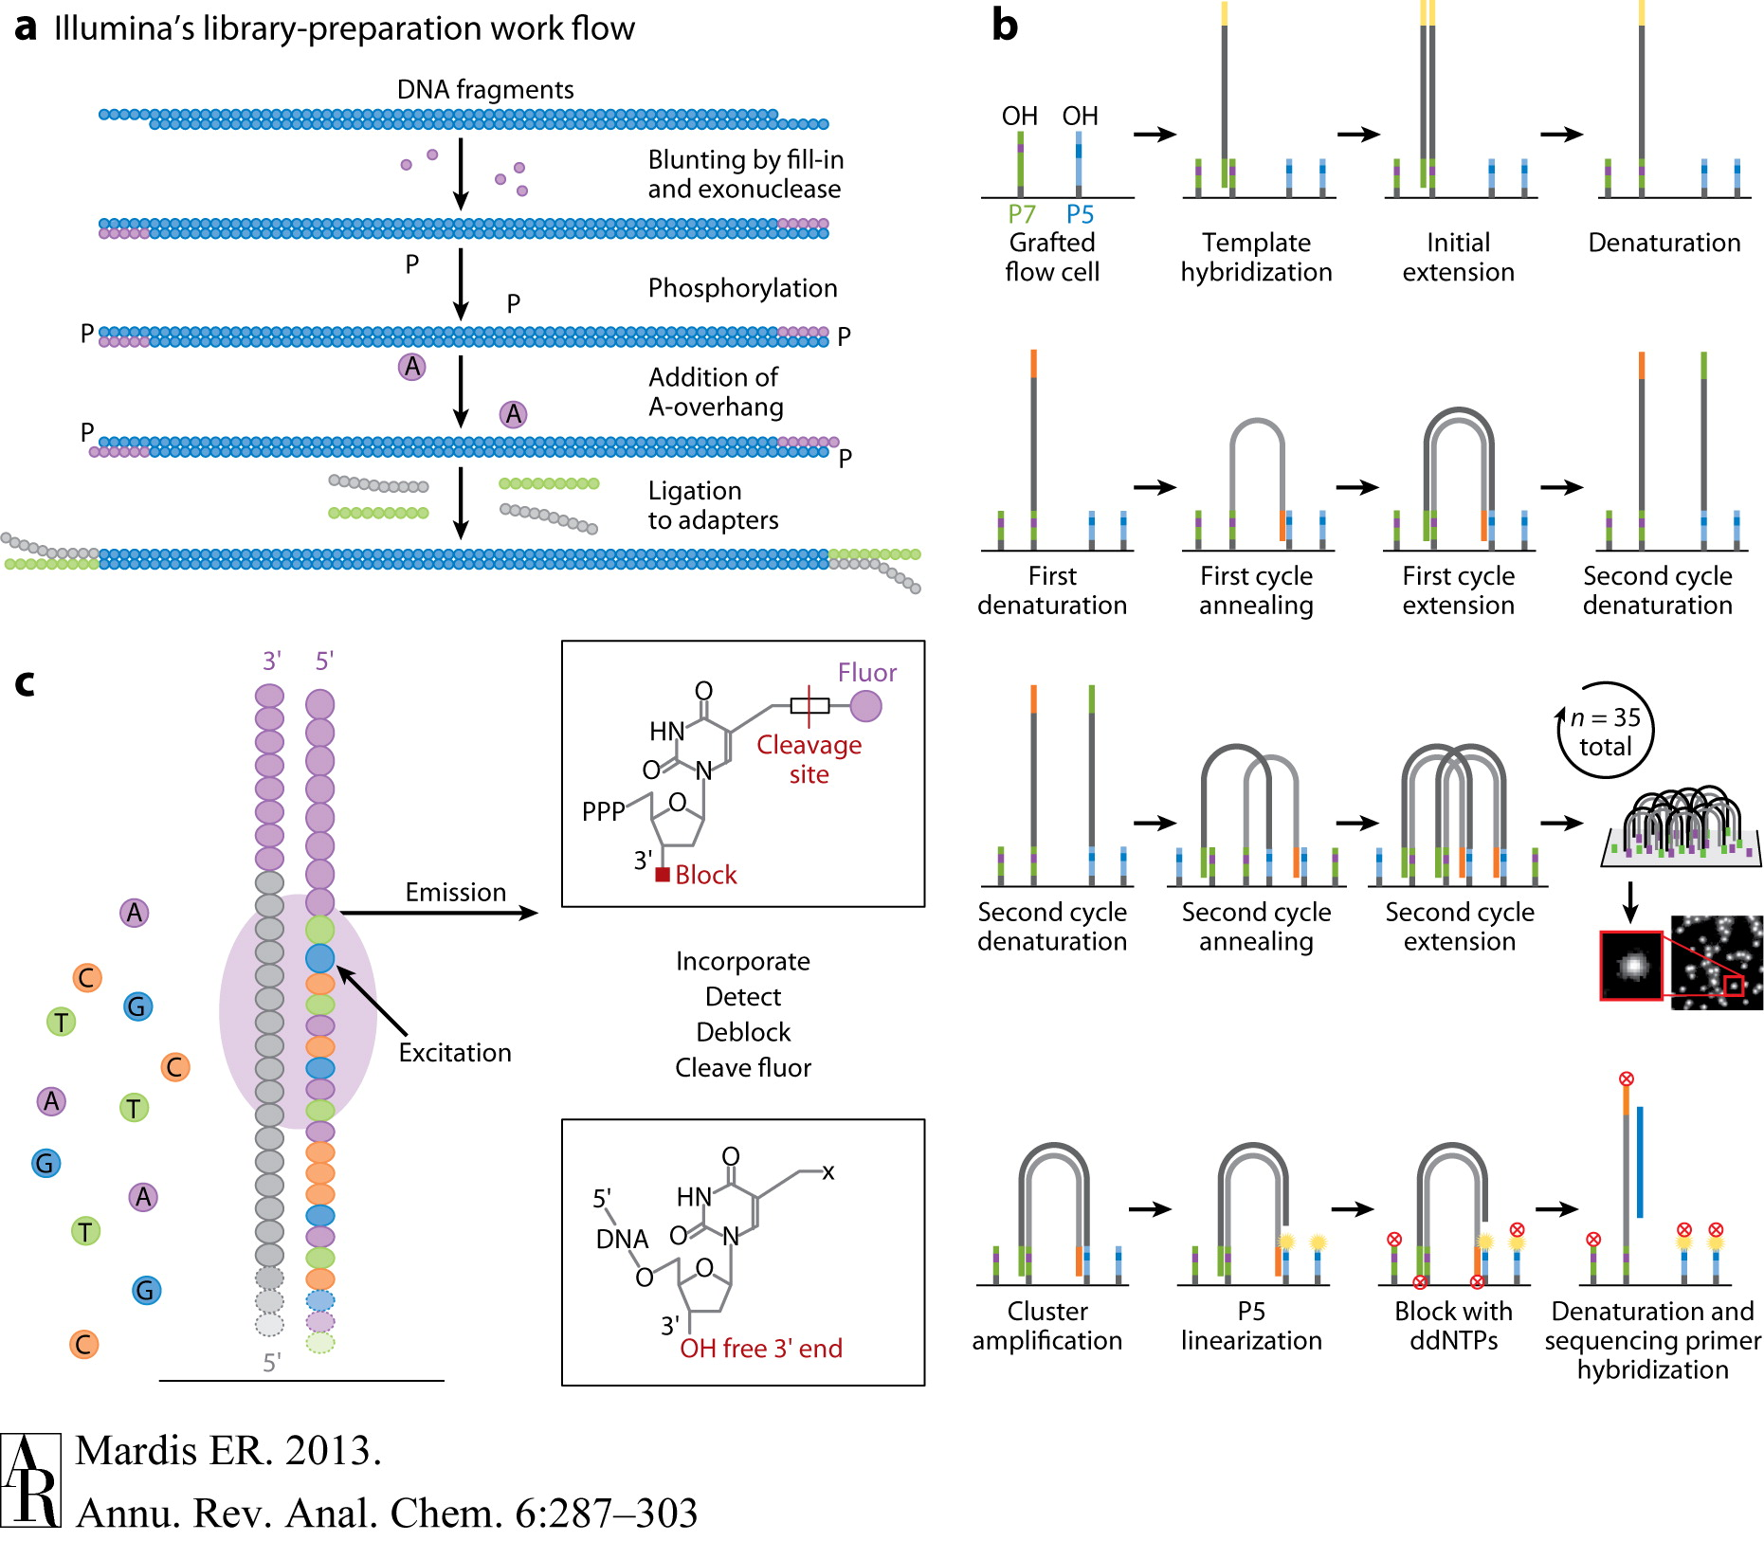
Sequencing by synthesis
https://www.youtube.com/watch?v=HMyCqWhwB8E

Slide 8
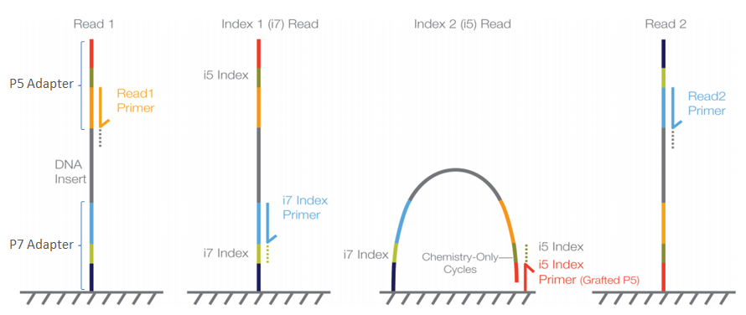
Sequencing by synthesis
https://support.illumina.com/bulletins/2016/04/adapter-trimming-why-are-adapter-sequences-trimmed-from-only-the--ends-of-reads.html

Slide 9
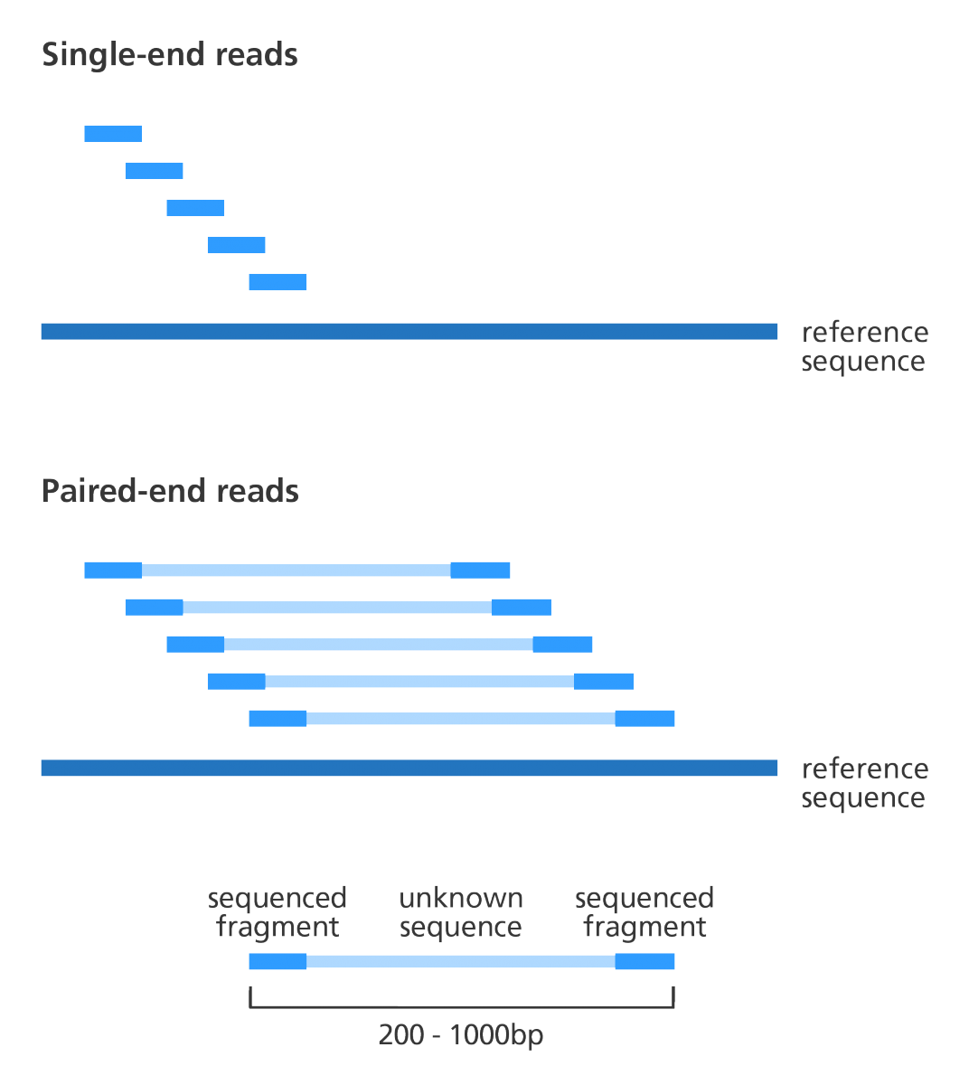
Single-end read vs paired sequencing
https://www.biostars.org/p/267167/

Slide 10
Overview: Analysis
Raw sequencing signal
Base called raw files
Demultiplexing
FASTQ
Alignment to reference
Differential expression analysis
Counts per feature
SAM/BAM
Variants Calling

Slide 11
FASTA
>SEQUENCE_ID | Sequence ID
GATTTGGGGTTCAAAGCAGTATCGATCAAATAGTAAATCCATTTGTTCAACTCACAGTTT | Raw sequence letters
FASTA format is used for reference genomes, primer or barcode sequences etc.

Slide 12
FASTQ
@SEQUENCE_ID | Sequence ID
GATTTGGGGTTCAAAGCAGTATCGATCAAATAGTAAATCCATTTGTTCAACTCACAGTTT | Raw sequence letters
+ | ??????
!''*((((***+))%%%++)(%%%%).1***-+*''))**55CCF>>>>>>CCCCCCC65 | Quality Scores encoded as Phred Quality+33
Following demultiplexing, raw sequence reads are obtained in FASTQ format. These files are also typically gzipped and have the extension .fastq.gz.

Slide 13
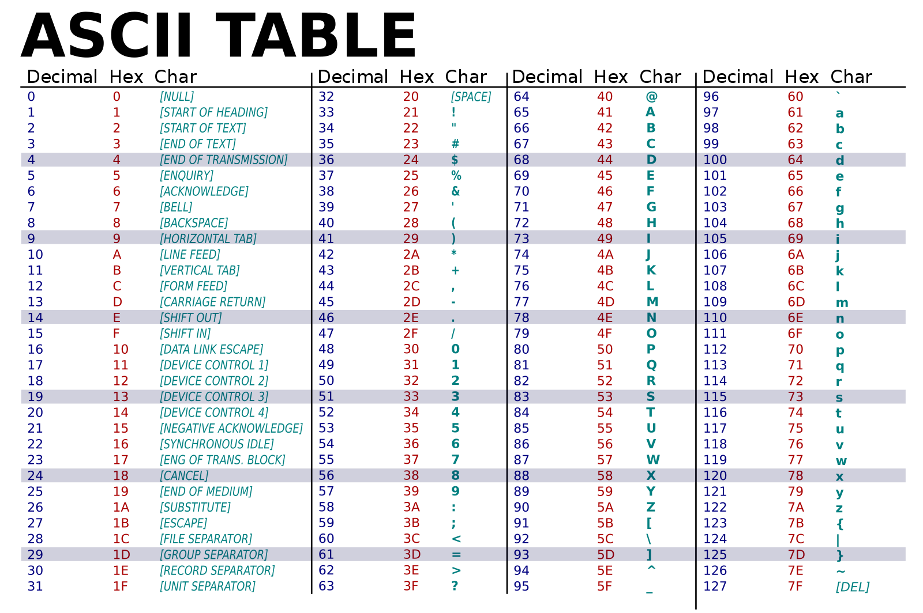
https://simple.wikipedia.org/wiki/ASCII

Slide 14
Phred Quality Score
Phred Quality Score | Probability of incorrect base call | Base call accuracy
10 | 0.1 | 90%
20 | 0.01 | 99%
30 | 0.001 | 99.9%
40 | 0.0001 | 99.99%
50 | 0.00001 | 99.999%

Slide 15
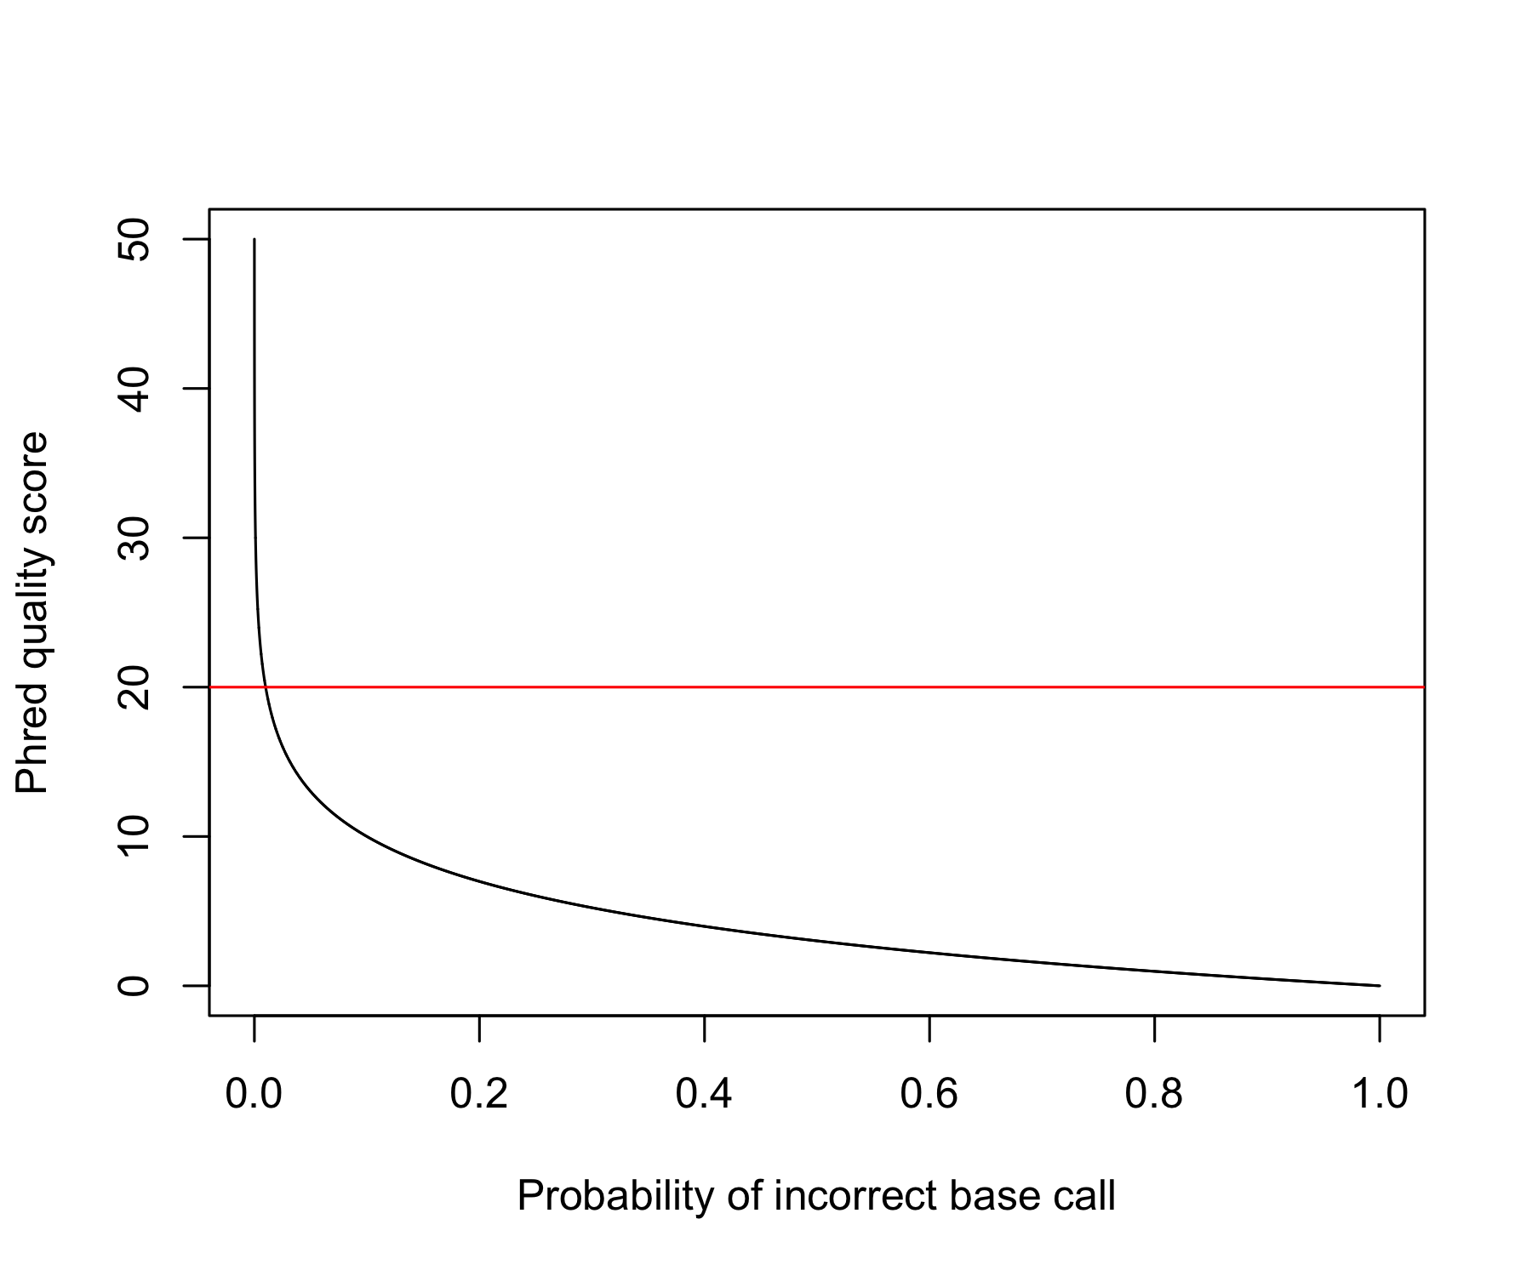
Exercise: Plot Phred Quality vs probability of incorrect base call

Slide 16
FastQC: Generates quality reports from fastq files
https://www.bioinformatics.babraham.ac.uk/projects/fastqc/
Commands:
fastqc example_1.fastq
(to load the fastqc module so you can run it, first execute module load fastqc)

Slide 17
FastQC: Generates quality reports from fastq files
https://www.bioinformatics.babraham.ac.uk/projects/fastqc/
Example reports from the tool homepage:
Good illumina data
Bad illumina data

Slide 18
Demonstration of FastQC

